Slide 1



Hardware and Software Fundamentals of Intelligent Computing Systems

Slide 2
Lecture 39: In-Depth Operator Performance Profiling Lab

Slide 3
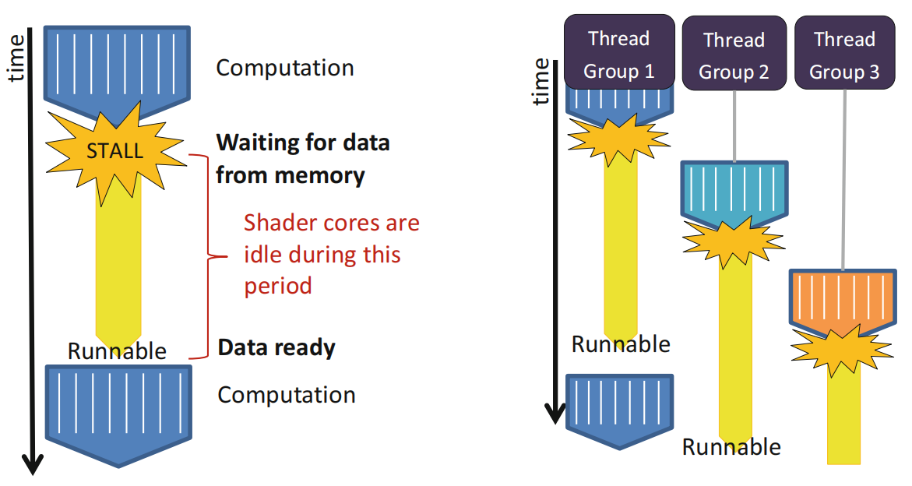
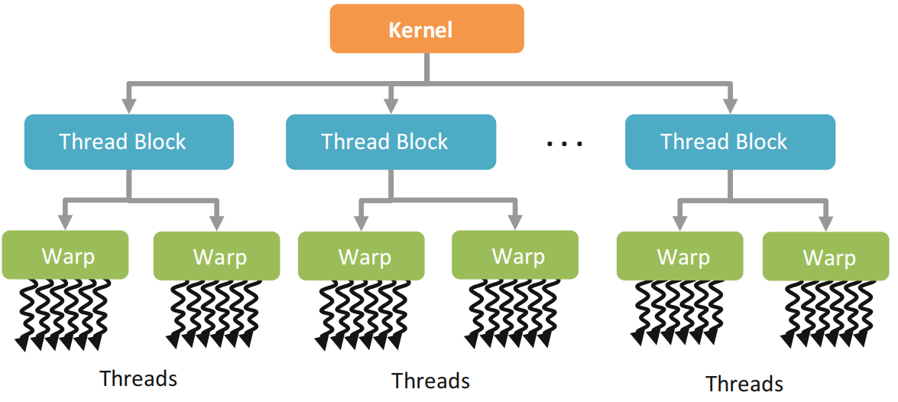
GPU Architecture
Execution model
GPU execution without/with batched thread groups
Single-instruction multiple threads (SIMT)
Hierachical thread execution model

Slide 4
Occupancy – Registers
The availability of registers is one of the major limiting factor for larger kernels
Example: Consider a GPU with 16384 registers per SM running a kernel that requires 35 registers per thread
Each SM can execute at most 468 threads
This affects the choice of block size
A block size of 512 is not possible
Only 1 block of 256 threads is allowed at a time, even though 212 more threads could be running
3 blockss of 128 threads are allowed, providing 384 threads to be scheduled, etc.

Slide 5
Occupancy – Registers
Consider another example:
A GPU has 16384 registers per SM
The block size of a kernel is fixed at 256 threads
The kernel currently requires 17 registers per thread
Given the information, each block requires 4352 registers
This allows for 3 active blocks if registers are the only limiting factor
If the code can be restructured to only use 16 registers, then 4 active blocks would be possible

Slide 6
Occupancy – Shared Memory
GPUs have a limited amount of shared memory on each SM
tens or a hundred KB of shared memory on recent GPUs
Shared memory limits the number of active blocks per SM
Depending on the kernel, the data per block may be fixed regardless of number of threads (e.g., histograms), or may vary based on the number of threads (e.g., matrix multiplication, convolution)

Slide 7
Occupancy – Threads
GPUs have hardware limitations on the maximum number of threads per block
256 threads per block on AMD GPUs
512 threads per block on NVIDIA GPUs
NVIDIA GPUs have per-SM limits on the number of active threads and blocks (depending on the GPU model)
for example, 768 or 1024 threads per SM
for example, 8 or 16 warps per SM
AMD GPUs have GPU-wide limits on the number of wavefronts
496 wavefronts on the 5870 GPU (~25 wavefronts or ~1600 threads per compute unit)

Slide 8
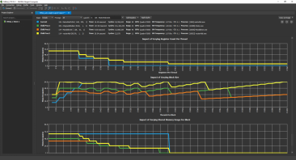
Occupancy – Limiting Factors
The minimum of these three factors is what limits the active number of threads (or occupancy) of a compute unit
The interactions between the factors are complex
The limiting factor may have either thread or wavefront granularity
Changing work group size may affect register or shared memory usage
Reducing any factor (such as register usage) slightly may have allow another work group to be active
The Nsight occupancy calculator from NVIDIA plots these factors visually allowing the tradeoffs to be visualized

Slide 9
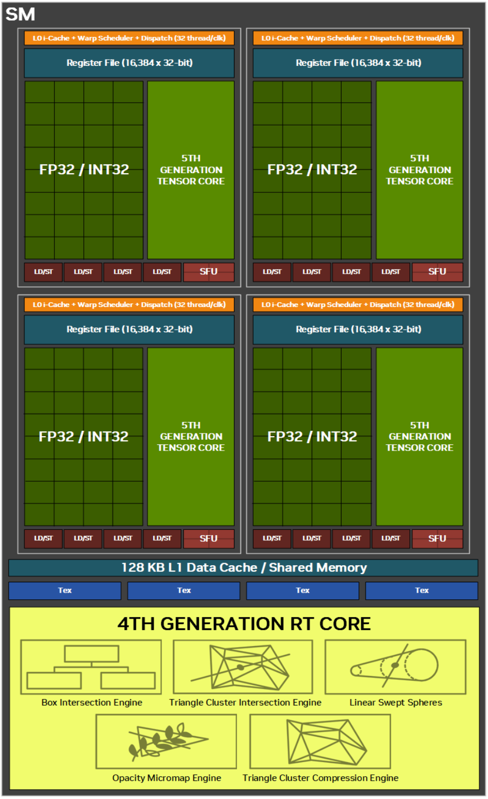
Occupancy: Tradeoffs
Shared memory and registers are persistent within SM when other warps execute
Allows for lower overhead context switch
The number of active warps that can be supported per SM is limited
Decided by the shared memory per block and register usage per thread
The number of active warps possible on an SM can be expressed using a metric called utilization
Larger numbers of active warps allow for better latency hiding on both NV and AMD hardware

Slide 10
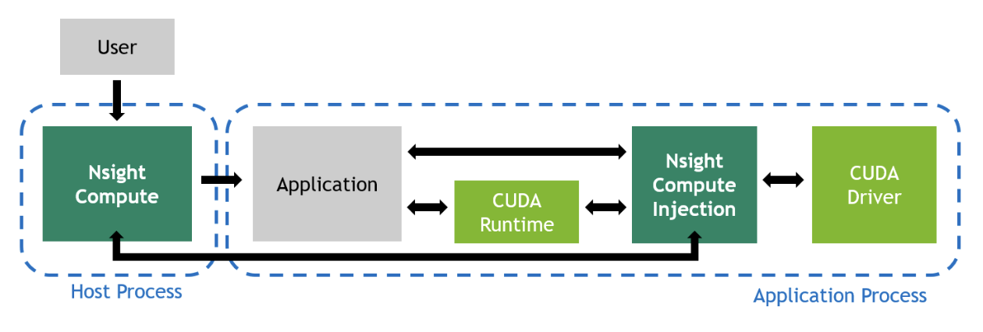
Nsight Compute
CUDA kernel profiler.
Curates performance statistics into targeted metrics.
Able to select amount of data to collect and how it’s presented
Fully featured Command Line and User Friendly GUI interfaces

Slide 11
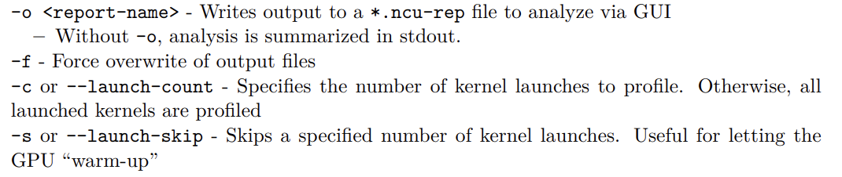
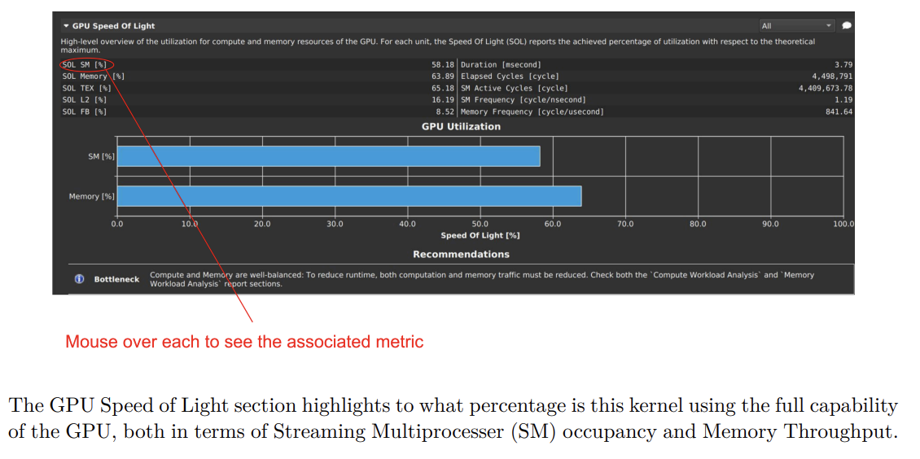
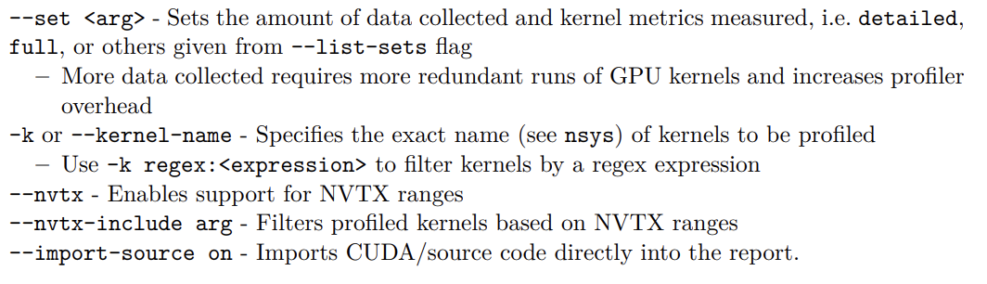
Nsight Compute
Nsight Compute CLI Options
Nsight Compute - GPU Speed of Light

Slide 12
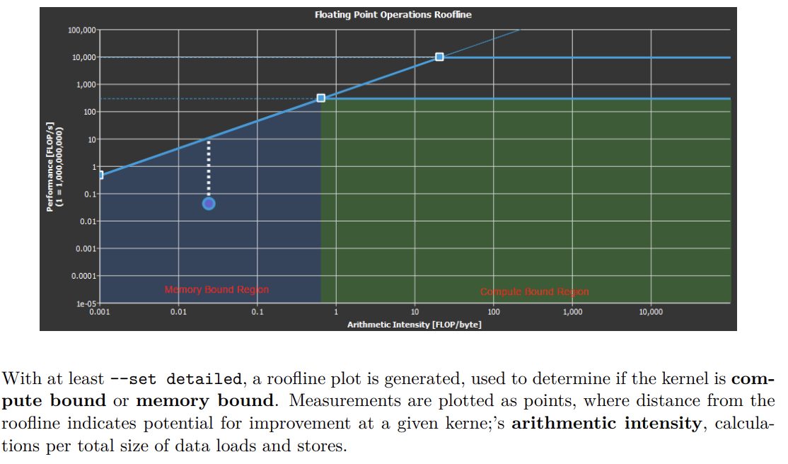
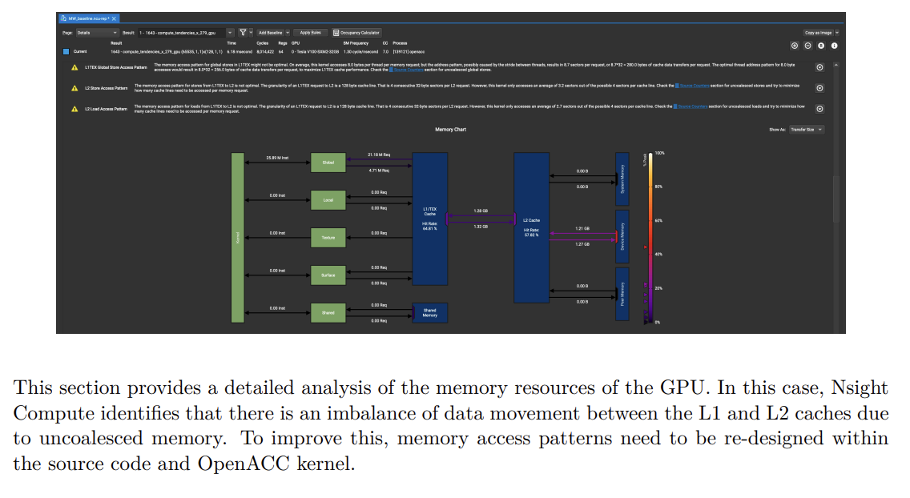
Nsight Compute
Nsight Compute - Roofline Analysis
Nsight Compute - Memory Workload Analysis

Slide 13
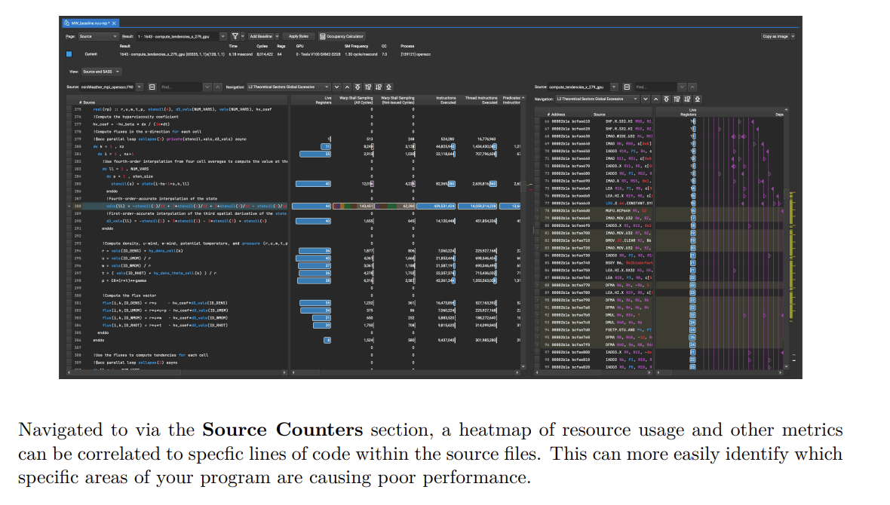
Nsight Compute
Nsight Compute - Source/SASS and Instruction Hotspots

Slide 14
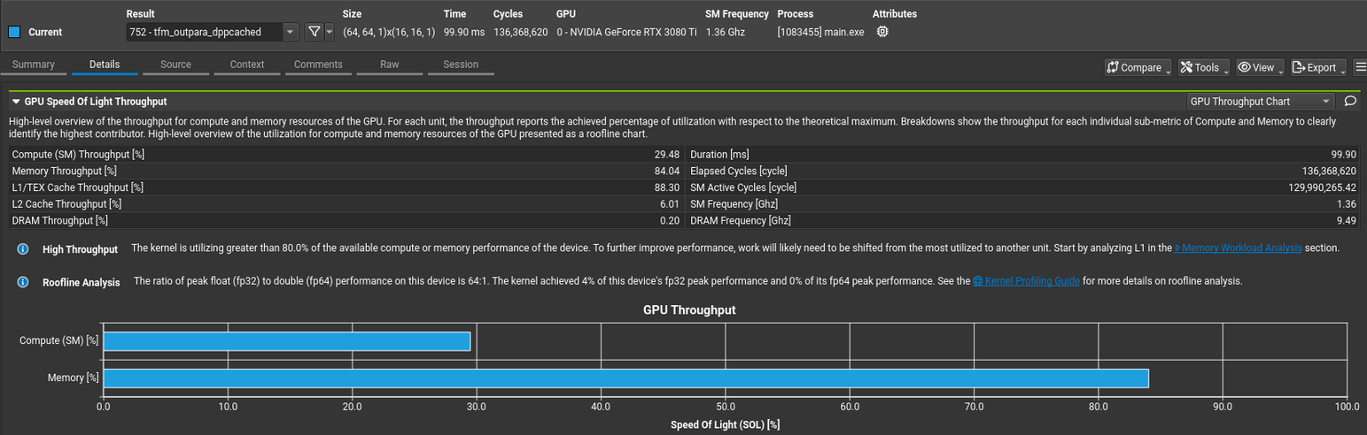
Nsight Compute Profiling Report Example (1/3)

Slide 15
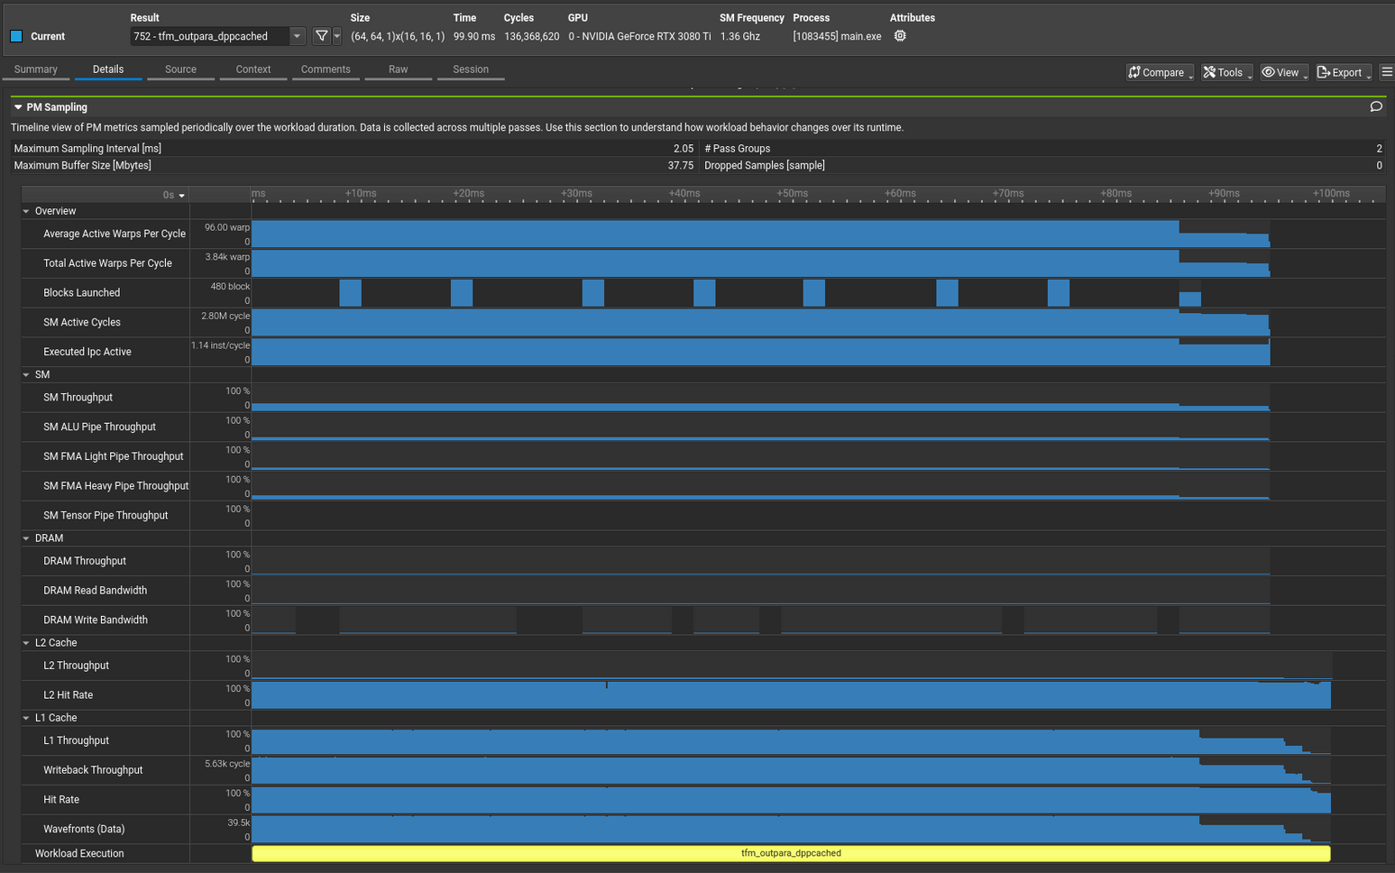
Nsight Compute Profiling Report Example (2/3)

Slide 16
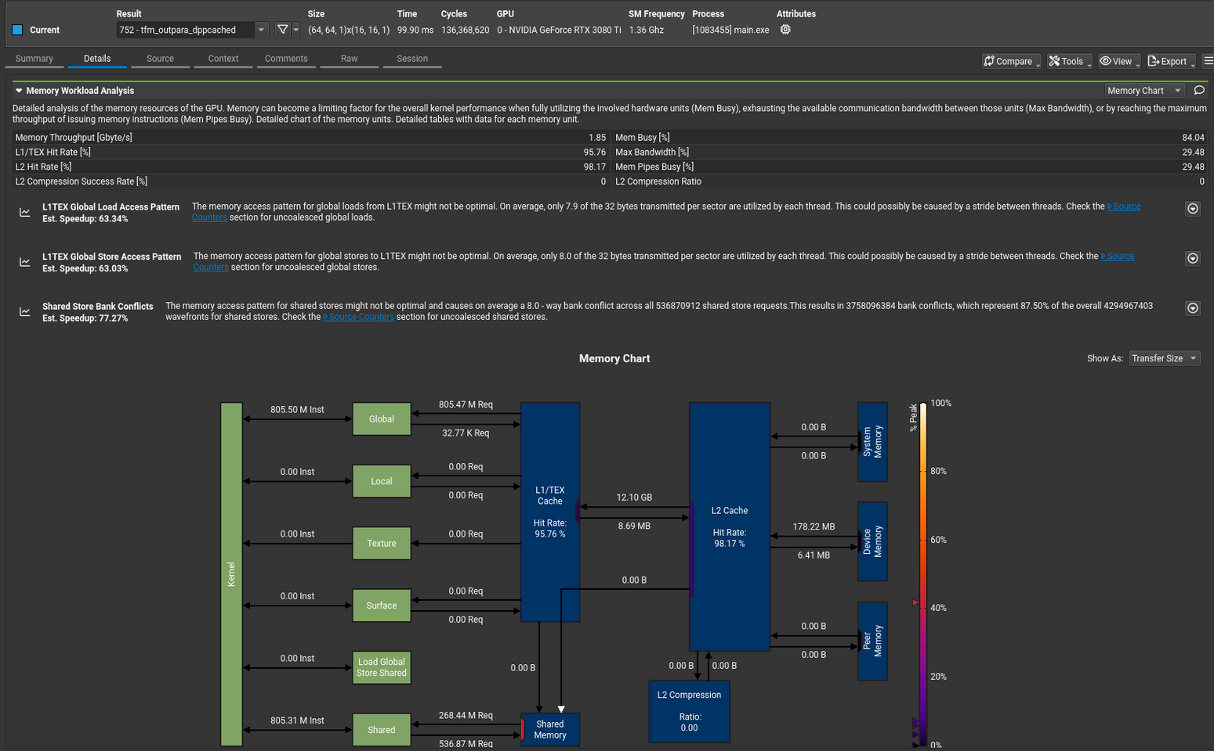
Nsight Compute Profiling Report Example (3/3)

Slide 17

The Solution: FlagOS, a Unified AI Software Stack

Slide 18








https://space.bilibili.com/3546791834290849
https://github.com/flagos-ai
https://www.zhihu.com/people/95-22-20-18/posts
https://flagos.io/Home

Slide 19

Thanks for your time！

